Slide 1

Dive into Deep Learning
Chapter 2:
Preliminaries Linear Algebra

Slide 2
Contents
Data Manipulation
Reading the Dataset
Handling Missing Data
Linear Algebra
Scalars
Automatic Differentiation
Probability
Calculus
Documentation
Data Preprocessing
Conversion to the Tensor Format
Matrices
Tensors
Getting Started
Operations
Broadcasting Mechanism
Indexing and Slicing
Saving Memory
Conversion to Other Python Objects
Vectors
Basic Properties of Tensor Arithmetic
Derivatives and Differentiation
Partial Derivatives
Gradients
Chain Rule
A Simple Example
Backward for Non-Scalar Variables
Detaching Computation
Computing the Gradient of Python Control Flow
Basic Probability Theory
Dealing with Multiple Random Variables
Expectation and Variance
Finding All the Functions and Classes in a Module
Finding the Usage of Specific Functions and Classes
+6 sections
Linear Algebra cont.
Reduction
Dot Products
Matrix-Vector Products
Matrix-Matrix Multiplication
Norms
More on Linear Algebra

Slide 3
Contents
CH2
Data Manipulation
Data Preprocessing
Linear Algebra
Linear Algebra cont.
Calculus
Automatic Differentiation
Probability
Documentation
Getting Started
Reading the Dataset
Scalars
Reduction
Derivatives and Differentiation
A Simple Example
Basic Probability Theory
Finding All the Functions and Classes in a Module
Operations
Handling Missing Data
Vectors
Dot Products
Partial Derivatives
Backward for Non-Scalar Variables
Dealing with Multiple Random Variables
Finding the Usage of Specific Functions and Classes
Broadcasting Mechanism
Conversion to the Tensor Format
Matrices
Matrix-Vector Products
Gradients
Detaching Computation
Expectation and Variance
Indexing and Slicing
Tensors
Matrix-Matrix Multiplication
Chain Rule
Computing the Gradient of Python Control Flow
Saving Memory
Basic Properties of Tensor Arithmetic
Norms
Conversion to Other Python Objects
+6 sections
More on Linear Algebra

Slide 4
Linear Algebra
We introduce the basic mathematical objects, arithmetic, and operations in linear algebra, expressing each of them through mathematical notation and the corresponding implementation in code.

Slide 5
Contents
CH2
Data Manipulation
Data Preprocessing
Linear Algebra
Linear Algebra cont.
Calculus
Automatic Differentiation
Probability
Documentation
Getting Started
Reading the Dataset
Scalars
Reduction
Derivatives and Differentiation
A Simple Example
Basic Probability Theory
Finding All the Functions and Classes in a Module
Operations
Handling Missing Data
Vectors
Dot Products
Partial Derivatives
Backward for Non-Scalar Variables
Dealing with Multiple Random Variables
Finding the Usage of Specific Functions and Classes
Broadcasting Mechanism
Conversion to the Tensor Format
Matrices
Matrix-Vector Products
Gradients
Detaching Computation
Expectation and Variance
Indexing and Slicing
Tensors
Matrix-Matrix Multiplication
Chain Rule
Computing the Gradient of Python Control Flow
Saving Memory
Basic Properties of Tensor Arithmetic
Norms
Conversion to Other Python Objects
+6 sections
More on Linear Algebra

Slide 6
Scalars
we call values consisting of just one numerical quantity scalars.
Variables are placeholders for unknown scalars.
A scalar is represented by a tensor with just one element.
In the next snippet, we instantiate two scalars and perform arithmetic operations with them.
from mxnet import np, npx
npx.set_np()
x = np.array(3.0)
y = np.array(2.0)
x + y, x * y, x/y, x**y

Slide 7
Contents
CH2
Data Manipulation
Data Preprocessing
Linear Algebra
Linear Algebra cont.
Calculus
Automatic Differentiation
Probability
Documentation
Getting Started
Reading the Dataset
Scalars
Reduction
Derivatives and Differentiation
A Simple Example
Basic Probability Theory
Finding All the Functions and Classes in a Module
Operations
Handling Missing Data
Vectors
Dot Products
Partial Derivatives
Backward for Non-Scalar Variables
Dealing with Multiple Random Variables
Finding the Usage of Specific Functions and Classes
Broadcasting Mechanism
Conversion to the Tensor Format
Matrices
Matrix-Vector Products
Gradients
Detaching Computation
Expectation and Variance
Indexing and Slicing
Tensors
Matrix-Matrix Multiplication
Chain Rule
Computing the Gradient of Python Control Flow
Saving Memory
Basic Properties of Tensor Arithmetic
Norms
Conversion to Other Python Objects
+6 sections
More on Linear Algebra

Slide 8
Vectors
You can think of a vector as simply a list of scalar values.
We call these values the elements (entries or components) of the vector.
When our vectors represent examples from our dataset, their values hold some real-world significance.
For example, if we were training a model to predict the risk that a loan defaults, we associate each applicant with a vector whose components correspond to their income, length of employment, number of previous defaults, and other factors.
We work with vectors via one-dimensional tensors.
Tensors can have arbitrary lengths, subject to the memory limits of your machine.
x = np.arange(4)
x

Slide 9
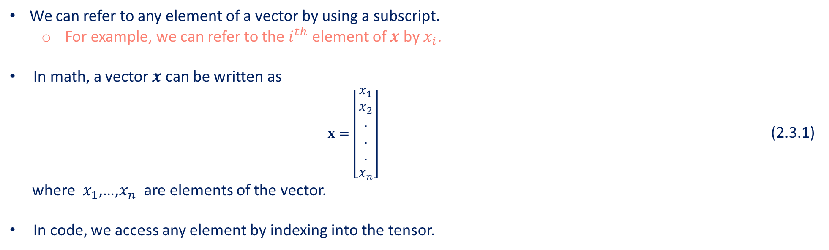
Vectors
We can refer to any element of a vector by using a subscript.
For example, we can refer to the $i^{th}$ element of $x$ by $x_{i}$.
In math, a vector $x$ can be written as
$x=\left[\begin{aligned}x_{1} \\ x_{2} \\ . \\ . \\ . \\ x_{n}\end{aligned}\right]$ (2.3.1)
where $x_{1}$,…,$x_{n}$ are elements of the vector.
In code, we access any element by indexing into the tensor.
x[3]
The length of a vector is commonly called the dimension of the vector.
We can access the length of a tensor by calling Python’s built-in $len()$function.
len(x)

Slide 10
Vectors
When a tensor represents a vector (with precisely one axis), we can also access its length via the $.shape$attribute.
The shape is a tuple that lists the length (dimensionality) along each axis of the tensor.
For tensors with just one axis, the shape has just one element.
x.shape
We use the dimensionality of a vector or an axis to refer to its length.
i.e., the number of elements of a vector or an axis.
We use the dimensionality of a tensor to refer to the number of axes that a tensor has.
In this sense, the dimensionality of some axis of a tensor will be the length of that axis.

Slide 11
Contents
CH2
Data Manipulation
Data Preprocessing
Linear Algebra
Linear Algebra cont.
Calculus
Automatic Differentiation
Probability
Documentation
Getting Started
Reading the Dataset
Scalars
Reduction
Derivatives and Differentiation
A Simple Example
Basic Probability Theory
Finding All the Functions and Classes in a Module
Operations
Handling Missing Data
Vectors
Dot Products
Partial Derivatives
Backward for Non-Scalar Variables
Dealing with Multiple Random Variables
Finding the Usage of Specific Functions and Classes
Broadcasting Mechanism
Conversion to the Tensor Format
Matrices
Matrix-Vector Products
Gradients
Detaching Computation
Expectation and Variance
Indexing and Slicing
Tensors
Matrix-Matrix Multiplication
Chain Rule
Computing the Gradient of Python Control Flow
Saving Memory
Basic Properties of Tensor Arithmetic
Norms
Conversion to Other Python Objects
+6 sections
More on Linear Algebra

Slide 12
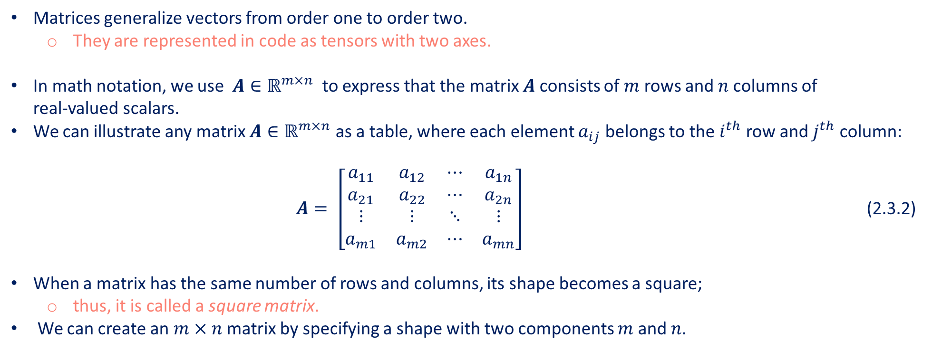
Matrices
Matrices generalize vectors from order one to order two.
They are represented in code as tensors with two axes.
In math notation, we use $A∈ℝ^{m×n}$ to express that the matrix $A$ consists of $m$ rows and $n$ columns of real-valued scalars.
We can illustrate any matrix $A∈ℝ^{m×n}$ as a table, where each element $a_{ij}$ belongs to the $i^{th}$ row and $j^{th}$ column: $A= \left[\begin{matrix}a_{11} & a_{12} & ⋯ & a_{1n} \\ a_{21} & a_{22} & ⋯ & a_{2n} \\ ⋮ & ⋮ & ⋱ & ⋮ \\ a_{m1} & a_{m2} & ⋯ & a_{mn}\end{matrix}\right]$ (2.3.2)
When a matrix has the same number of rows and columns, its shape becomes a square;
thus, it is called a square matrix.
We can create an $m×n$ matrix by specifying a shape with two components $m$ and $n$.
A = np.arange(20).reshape(5,4)
A

Slide 13
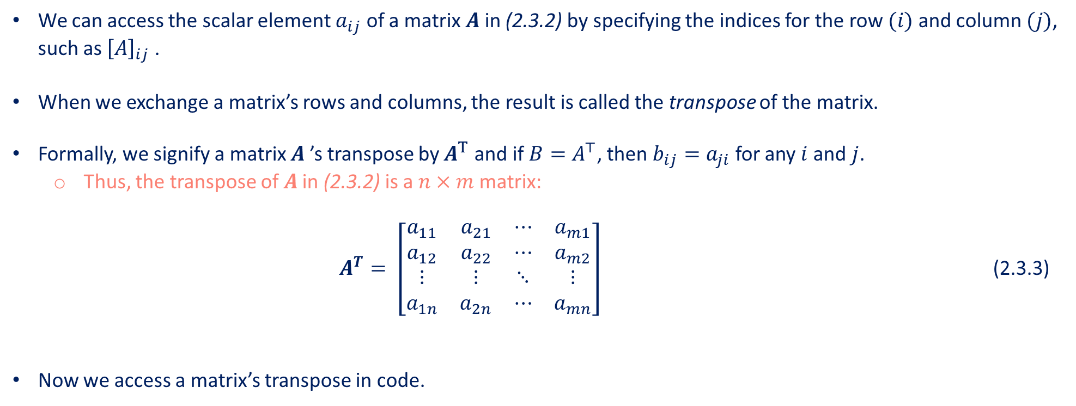
Matrices
We can access the scalar element $a_{ij}$ of a matrix $A$ in (2.3.2) by specifying the indices for the row $(i)$ and column $(j)$, such as ${\left[A\right]}_{ij}$ .
When we exchange a matrix’s rows and columns, the result is called the transpose of the matrix.
Formally, we signify a matrix $A$ ’s transpose by $A^{T}$ and if $B=A^{⊤}$, then $b_{ij}=a_{ji}$ for any $i$ and $j$.
Thus, the transpose of $A$ in (2.3.2) is a $n×m$ matrix: $A^{T}= \left[\begin{matrix}a_{11} & a_{21} & ⋯ & a_{m1} \\ a_{12} & a_{22} & ⋯ & a_{m2} \\ ⋮ & ⋮ & ⋱ & ⋮ \\ a_{1n} & a_{2n} & ⋯ & a_{mn}\end{matrix}\right]$ (2.3.3)
Now we access a matrix’s transpose in code.
A.T

Slide 14
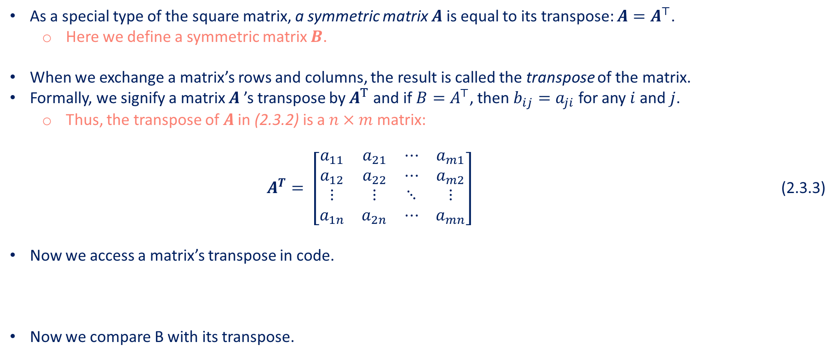
Matrices
As a special type of the square matrix, a symmetric matrix $A$ is equal to its transpose: $A=A^{⊤}$.
Here we define a symmetric matrix $B$.
When we exchange a matrix’s rows and columns, the result is called the transpose of the matrix.
Formally, we signify a matrix $A$ ’s transpose by $A^{T}$ and if $B=A^{⊤}$, then $b_{ij}=a_{ji}$ for any $i$ and $j$.
Thus, the transpose of $A$ in (2.3.2) is a $n×m$ matrix: $A^{T}= \left[\begin{matrix}a_{11} & a_{21} & ⋯ & a_{m1} \\ a_{12} & a_{22} & ⋯ & a_{m2} \\ ⋮ & ⋮ & ⋱ & ⋮ \\ a_{1n} & a_{2n} & ⋯ & a_{mn}\end{matrix}\right]$ (2.3.3)
Now we access a matrix’s transpose in code.
Now we compare B with its transpose.
B = np.array([[1,2,3],[2,0,4],[3,4,5]])
B
B == B.T

Slide 15
Contents
CH2
Data Manipulation
Data Preprocessing
Linear Algebra
Linear Algebra cont.
Calculus
Automatic Differentiation
Probability
Documentation
Getting Started
Reading the Dataset
Scalars
Reduction
Derivatives and Differentiation
A Simple Example
Basic Probability Theory
Finding All the Functions and Classes in a Module
Operations
Handling Missing Data
Vectors
Dot Products
Partial Derivatives
Backward for Non-Scalar Variables
Dealing with Multiple Random Variables
Finding the Usage of Specific Functions and Classes
Broadcasting Mechanism
Conversion to the Tensor Format
Matrices
Matrix-Vector Products
Gradients
Detaching Computation
Expectation and Variance
Indexing and Slicing
Tensors
Matrix-Matrix Multiplication
Chain Rule
Computing the Gradient of Python Control Flow
Saving Memory
Basic Properties of Tensor Arithmetic
Norms
Conversion to Other Python Objects
+6 sections
More on Linear Algebra

Slide 16
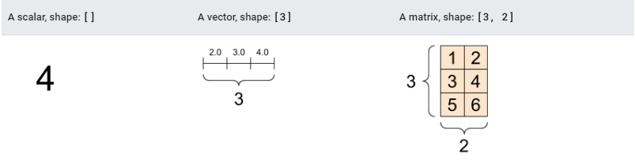
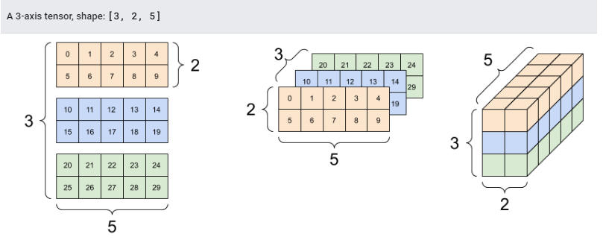
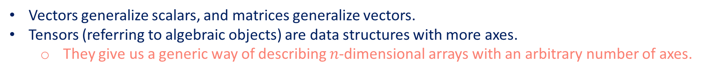
Tensors
Vectors generalize scalars, and matrices generalize vectors.
Tensors (referring to algebraic objects) are data structures with more axes.
They give us a generic way of describing $n$-dimensional arrays with an arbitrary number of axes.
Introduction to Tensors

Slide 17
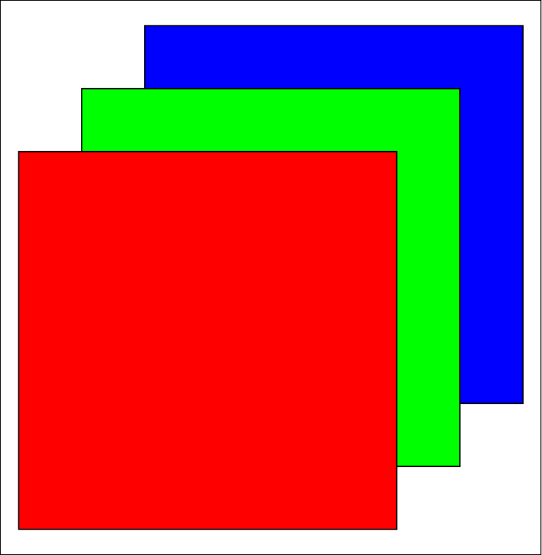
Tensors
Vectors, are first-order tensors, and matrices are second-order tensors.
Tensors indexing mechanism (e.g., $x_{ijk}$ and ${\left[X\right]}_{1,2i−1,3}$ ) is similar to that of matrices.
Tensors are important when we work with images, which arrive as $n$-dimensional arrays with 3 axes corresponding to Height, Width, Channel axis for stacking the color channels (red, green, and blue).
Height
Color channels
A basic tensor can be created as follows
Width
X = np.arange(24).reshape(2,3,4)
X

Slide 18
Contents
CH2
Data Manipulation
Data Preprocessing
Linear Algebra
Linear Algebra cont.
Calculus
Automatic Differentiation
Probability
Documentation
Getting Started
Reading the Dataset
Scalars
Reduction
Derivatives and Differentiation
A Simple Example
Basic Probability Theory
Finding All the Functions and Classes in a Module
Operations
Handling Missing Data
Vectors
Dot Products
Partial Derivatives
Backward for Non-Scalar Variables
Dealing with Multiple Random Variables
Finding the Usage of Specific Functions and Classes
Broadcasting Mechanism
Conversion to the Tensor Format
Matrices
Matrix-Vector Products
Gradients
Detaching Computation
Expectation and Variance
Indexing and Slicing
Tensors
Matrix-Matrix Multiplication
Chain Rule
Computing the Gradient of Python Control Flow
Saving Memory
Basic Properties of Tensor Arithmetic
Norms
Conversion to Other Python Objects
+6 sections
More on Linear Algebra

Slide 19
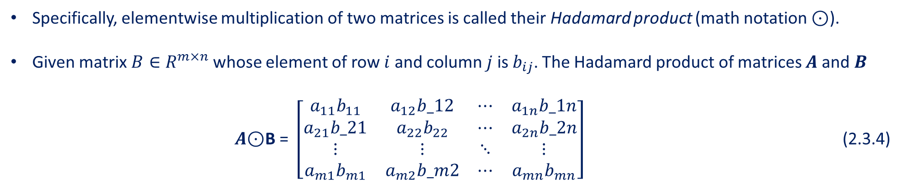
Basic Properties of Tensor Arithmetic
Given any two tensors with the same shape, the result of any binary elementwise operation will be a tensor of that same shape.
For example, adding two matrices of the same shape performs elementwise addition over these two matrices.
A = np.arange(20).reshape(5,4)
B = A.copy()
A, A+B
Specifically, elementwise multiplication of two matrices is called their Hadamard product (math notation ⊙).
Given matrix $B∈R^{m×n}$ whose element of row $i$ and column $j$ is $b_{ij}$. The Hadamard product of matrices $A$ and $B$
$A\text{⊙}\text{B} \text{= }\left[\begin{matrix}a_{11}b_{11} & a_{12}b_12 & ⋯ & a_{1n}b_1n \\ a_{21}b_21 & a_{22}b_{22} & ⋯ & a_{2n}b_2n \\ ⋮ & ⋮ & ⋱ & ⋮ \\ a_{m1}b_{m1} & a_{m2}b_m2 & ⋯ & a_{mn}b_{mn}\end{matrix}\right]$ (2.3.4)
A * B

Slide 20
Basic Properties of Tensor Arithmetic
Multiplying or adding a tensor by a scalar also does not change the shape of the tensor, where each element of the operand tensor will be added or multiplied by the scalar.
a = 2
X = np.arange(24).reshape(2,3,4)
a + X, (a*X).shape

Slide 21
Contents
CH2
Data Manipulation
Data Preprocessing
Linear Algebra
Linear Algebra cont.
Calculus
Automatic Differentiation
Probability
Documentation
Getting Started
Reading the Dataset
Scalars
Reduction
Derivatives and Differentiation
A Simple Example
Basic Probability Theory
Finding All the Functions and Classes in a Module
Operations
Handling Missing Data
Vectors
Dot Products
Partial Derivatives
Backward for Non-Scalar Variables
Dealing with Multiple Random Variables
Finding the Usage of Specific Functions and Classes
Broadcasting Mechanism
Conversion to the Tensor Format
Matrices
Matrix-Vector Products
Gradients
Detaching Computation
Expectation and Variance
Indexing and Slicing
Tensors
Matrix-Matrix Multiplication
Chain Rule
Computing the Gradient of Python Control Flow
Saving Memory
Basic Properties of Tensor Arithmetic
Norms
Conversion to Other Python Objects
+6 sections
More on Linear Algebra

Slide 22
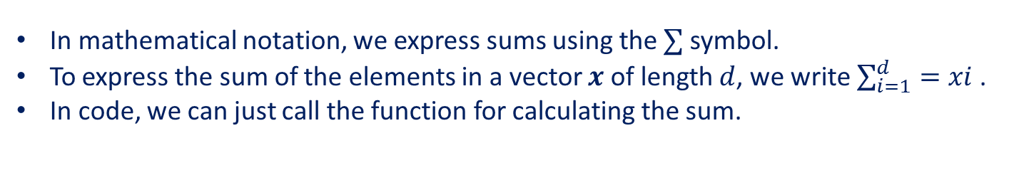
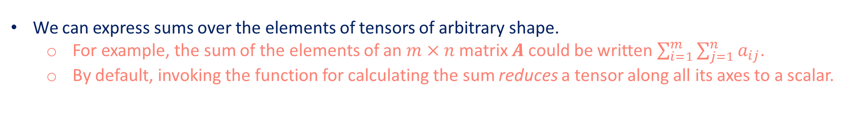
Reduction
In mathematical notation, we express sums using the $∑$ symbol.
To express the sum of the elements in a vector $x$ of length $d$, we write $\sum_{i=1}^{d}{=xi}$ .
In code, we can just call the function for calculating the sum.
x = np.arange(4)
x, x.sum()
We can express sums over the elements of tensors of arbitrary shape.
For example, the sum of the elements of an $m×n$ matrix $A$ could be written $\sum_{i=1}^{m}{\sum_{j=1}^{n}{a_{ij}}}$.
By default, invoking the function for calculating the sum reduces a tensor along all its axes to a scalar.
A.shape, A.sum()

Slide 23
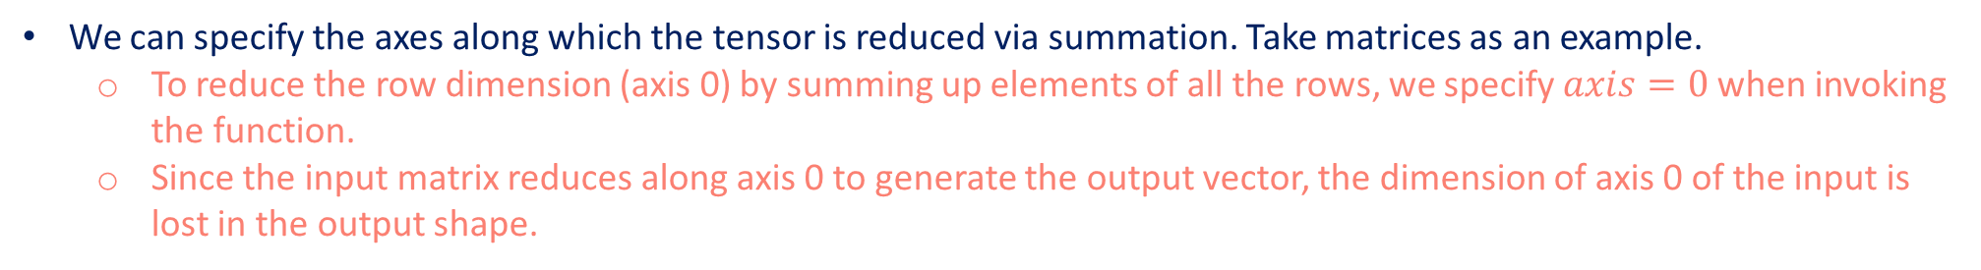
Reduction
We can specify the axes along which the tensor is reduced via summation. Take matrices as an example.
To reduce the row dimension (axis 0) by summing up elements of all the rows, we specify $axis=0$ when invoking the function.
Since the input matrix reduces along axis 0 to generate the output vector, the dimension of axis 0 of the input is lost in the output shape.
A_sum_axis0 = A.sum(axis=0)
A_sum_axis0, A_sum_axis0.shape
Specifying $axis=1$ will reduce the column dimension (axis 1) by summing up elements of all the columns.
Thus, the dimension of axis 1 of the input is lost in the output shape.
A_sum_axis1 = A.sum(axis=1)
A_sum_axis1, A_sum_axis1.shape

Slide 24
Reduction
Reducing a matrix along both rows and columns via summation is equivalent to summing up all the elements of the matrix.
A.sum(axis=[0, 1]) # Same as `A.sum()`
A related quantity is the mean, which is also called the average.
We calculate the mean by dividing the sum by the total number of elements.
A.mean(), A.sum() / A.size
The function for calculating the mean can also reduce a tensor along the specified axes.
A.mean(axis=0), A.sum(axis=0) / A.shape[0]

Slide 25
Reduction
It can be useful to keep the number of axes unchanged when invoking the function for calculating the sum or mean.
sum_A = A.sum(axis=1,keepdims=True)
sum_A
Since $sum_A$ still keeps its two axes after summing each row, we can divide $A$ by $sum_A$ with broadcasting.
A / sum_A
To calculate the cumulative sum of elements of $A$ along some axis, say axis=0 (row by row), we can call the $cumsum$ function.
This function will not reduce the input tensor along any axis.
A.cumsum(axis=0)

Slide 26
Contents
CH2
Data Manipulation
Data Preprocessing
Linear Algebra
Linear Algebra cont.
Calculus
Automatic Differentiation
Probability
Documentation
Getting Started
Reading the Dataset
Scalars
Reduction
Derivatives and Differentiation
A Simple Example
Basic Probability Theory
Finding All the Functions and Classes in a Module
Operations
Handling Missing Data
Vectors
Dot Products
Partial Derivatives
Backward for Non-Scalar Variables
Dealing with Multiple Random Variables
Finding the Usage of Specific Functions and Classes
Broadcasting Mechanism
Conversion to the Tensor Format
Matrices
Matrix-Vector Products
Gradients
Detaching Computation
Expectation and Variance
Indexing and Slicing
Tensors
Matrix-Matrix Multiplication
Chain Rule
Computing the Gradient of Python Control Flow
Saving Memory
Basic Properties of Tensor Arithmetic
Norms
Conversion to Other Python Objects
+6 sections
More on Linear Algebra

Slide 27
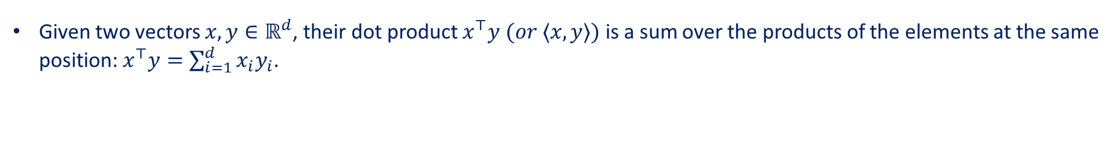
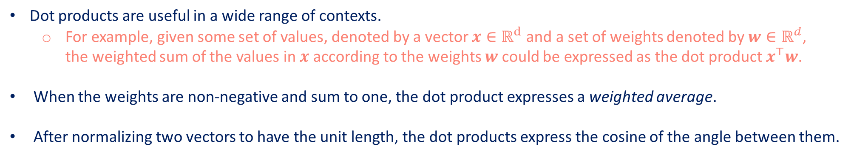
Dot Products
Given two vectors $x,y∈ℝ^{d}$, their dot product $x^{⊤}y (or ⟨x,y⟩)$ is a sum over the products of the elements at the same position: $x^{⊤}y=\sum_{i=1}^{d}{x_{i}y_{i}}$.
y = np.ones(4)
x,y, np.dot(x,y)
We can do the dot product of two vectors equivalently by performing an elementwise multiplication and then a sum:
np.sum(x * y)
Dot products are useful in a wide range of contexts.
For example, given some set of values, denoted by a vector $x∈ℝ^{d}$ and a set of weights denoted by $w∈ℝ^{d}$, the weighted sum of the values in $x$ according to the weights $w$ could be expressed as the dot product $x^{⊤}w$.
When the weights are non-negative and sum to one, the dot product expresses a weighted average.
After normalizing two vectors to have the unit length, the dot products express the cosine of the angle between them.

Slide 28
Contents
CH2
Data Manipulation
Data Preprocessing
Linear Algebra
Linear Algebra cont.
Calculus
Automatic Differentiation
Probability
Documentation
Getting Started
Reading the Dataset
Scalars
Reduction
Derivatives and Differentiation
A Simple Example
Basic Probability Theory
Finding All the Functions and Classes in a Module
Operations
Handling Missing Data
Vectors
Dot Products
Partial Derivatives
Backward for Non-Scalar Variables
Dealing with Multiple Random Variables
Finding the Usage of Specific Functions and Classes
Broadcasting Mechanism
Conversion to the Tensor Format
Matrices
Matrix-Vector Products
Gradients
Detaching Computation
Expectation and Variance
Indexing and Slicing
Tensors
Matrix-Matrix Multiplication
Chain Rule
Computing the Gradient of Python Control Flow
Saving Memory
Basic Properties of Tensor Arithmetic
Norms
Conversion to Other Python Objects
+6 sections
More on Linear Algebra

Slide 29
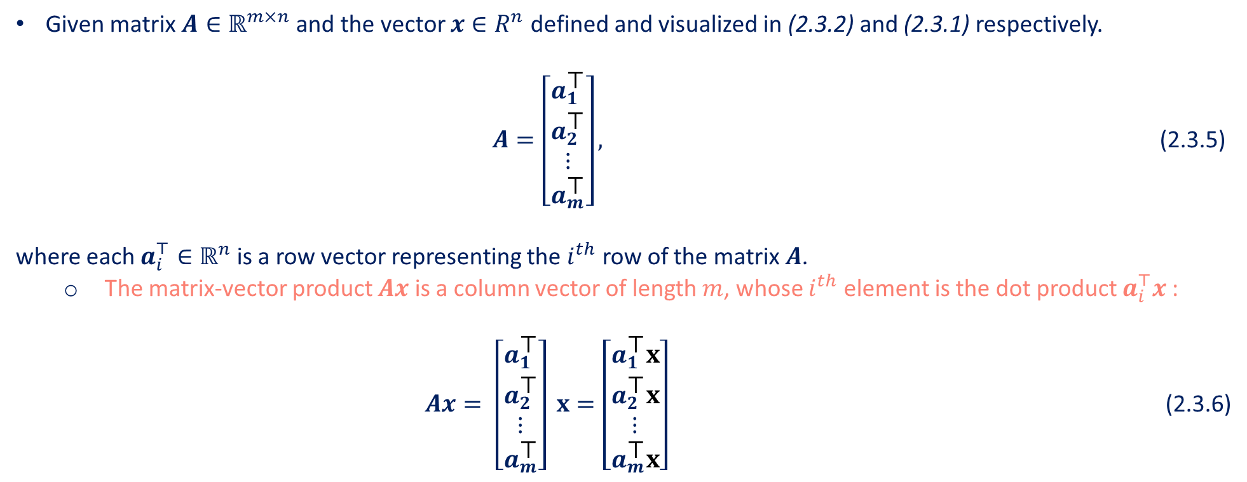
Matrix-Vector Products
Given matrix $A∈ℝ^{m×n}$ and the vector $x∈R^{n}$ defined and visualized in (2.3.2) and (2.3.1) respectively.
$A=\left[\begin{matrix}a_{1}^{\text{⊤}} \\ a_{2}^{\text{⊤}} \\ ⋮ \\ a_{m}^{\text{⊤}}\end{matrix}\right],$ (2.3.5)
where each $a_{i}^{⊤}∈ℝ^{n}$ is a row vector representing the $i^{th}$ row of the matrix $A$.
The matrix-vector product $Ax$ is a column vector of length $m$, whose $i^{th}$ element is the dot product $a_{i}^{⊤}x$ : $Ax= \left[\begin{matrix}a_{1}^{\text{⊤}} \\ a_{2}^{\text{⊤}} \\ ⋮ \\ a_{m}^{\text{⊤}}\end{matrix}\right] x=\left[\begin{matrix}a_{1}^{\text{⊤}}x \\ a_{2}^{\text{⊤}}x \\ ⋮ \\ a_{m}^{\text{⊤}}x\end{matrix}\right]$ (2.3.6)

Slide 30
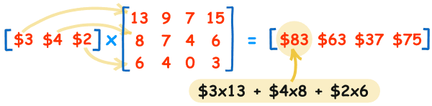
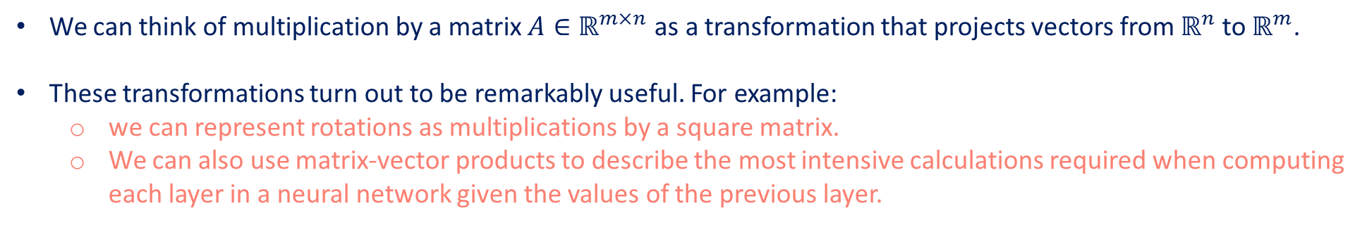
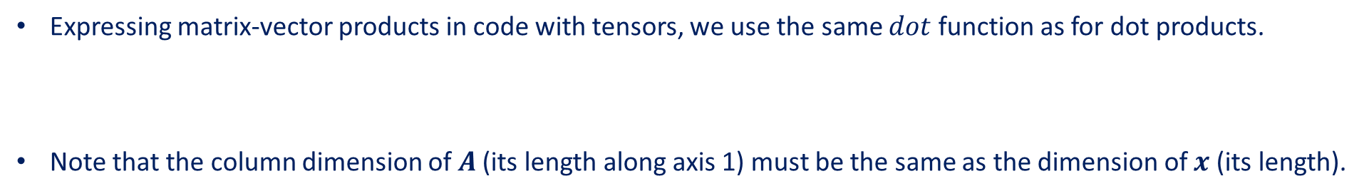
Matrix-Vector Products
We can think of multiplication by a matrix $A∈ℝ^{m×n}$ as a transformation that projects vectors from $ℝ^{n}$ to $ℝ^{m}$.
These transformations turn out to be remarkably useful. For example:
we can represent rotations as multiplications by a square matrix.
We can also use matrix-vector products to describe the most intensive calculations required when computing each layer in a neural network given the values of the previous layer.
Expressing matrix-vector products in code with tensors, we use the same $dot$ function as for dot products.
Note that the column dimension of $A$ (its length along axis 1) must be the same as the dimension of $x$ (its length).
A.shape, x.shape, np.dot(A,x)
Dot product between a vector and a matrix

Slide 31
Contents
CH2
Data Manipulation
Data Preprocessing
Linear Algebra
Linear Algebra cont.
Calculus
Automatic Differentiation
Probability
Documentation
Getting Started
Reading the Dataset
Scalars
Reduction
Derivatives and Differentiation
A Simple Example
Basic Probability Theory
Finding All the Functions and Classes in a Module
Operations
Handling Missing Data
Vectors
Dot Products
Partial Derivatives
Backward for Non-Scalar Variables
Dealing with Multiple Random Variables
Finding the Usage of Specific Functions and Classes
Broadcasting Mechanism
Conversion to the Tensor Format
Matrices
Matrix-Vector Products
Gradients
Detaching Computation
Expectation and Variance
Indexing and Slicing
Tensors
Matrix-Matrix Multiplication
Chain Rule
Computing the Gradient of Python Control Flow
Saving Memory
Basic Properties of Tensor Arithmetic
Norms
Conversion to Other Python Objects
+6 sections
More on Linear Algebra

Slide 32
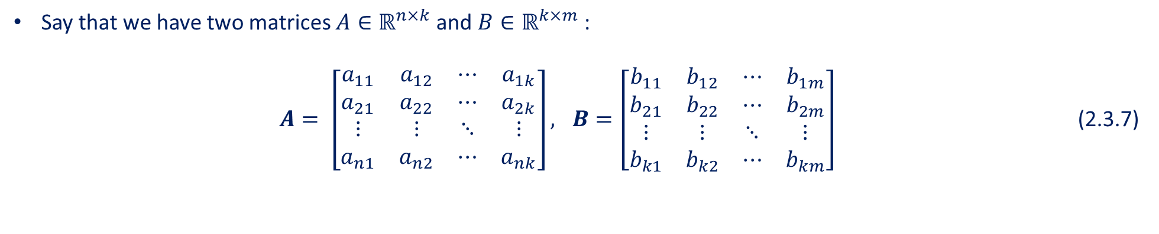
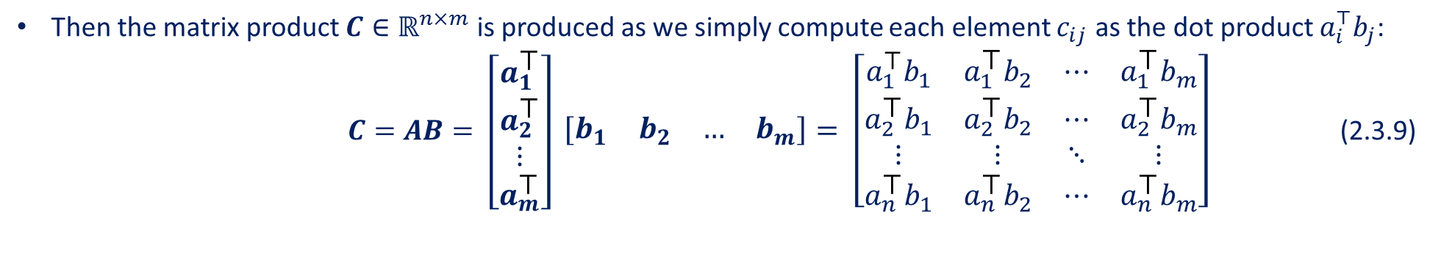
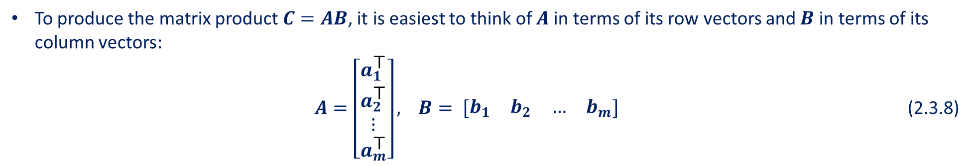
Matrix-Matrix Multiplication
Say that we have two matrices $A∈ℝ^{n×k}$ and $B∈ℝ^{k×m}$ :
$A= \left[\begin{matrix}a_{11} & a_{12} & ⋯ & a_{1k} \\ a_{21} & a_{22} & ⋯ & a_{2k} \\ ⋮ & ⋮ & ⋱ & ⋮ \\ a_{n1} & a_{n2} & ⋯ & a_{nk}\end{matrix}\right], B=\left[\begin{matrix}b_{11} & b_{12} & ⋯ & b_{1m} \\ b_{21} & b_{22} & ⋯ & b_{2m} \\ ⋮ & ⋮ & ⋱ & ⋮ \\ b_{k1} & b_{k2} & ⋯ & b_{km}\end{matrix}\right]$ (2.3.7)
To produce the matrix product $C=AB$, it is easiest to think of $A$ in terms of its row vectors and $B$ in terms of its column vectors:
$A=\left[\begin{matrix}a_{1}^{\text{⊤}} \\ a_{2}^{\text{⊤}} \\ ⋮ \\ a_{m}^{\text{⊤}}\end{matrix}\right],$ $B= \left[\begin{matrix}b_{1} & b_{2} & … & b_{m}\end{matrix}\right]$ (2.3.8)
Then the matrix product $C∈ℝ^{n×m}$ is produced as we simply compute each element $c_{ij}$ as the dot product $a_{i}^{⊤}b_{j}$:
$C=AB= \left[\begin{matrix}a_{1}^{\text{⊤}} \\ a_{2}^{\text{⊤}} \\ ⋮ \\ a_{m}^{\text{⊤}}\end{matrix}\right]$ $\left[\begin{matrix}b_{1} & b_{2} & … & b_{m}\end{matrix}\right]= \left[\begin{matrix}a_{1}^{\text{⊤}}b_{1} & a_{1}^{\text{⊤}}b_{2} & ⋯ & a_{1}^{\text{⊤}}b_{m} \\ a_{2}^{\text{⊤}}b_{1} & a_{2}^{\text{⊤}}b_{2} & ⋯ & a_{2}^{\text{⊤}}b_{m} \\ ⋮ & ⋮ & ⋱ & ⋮ \\ a_{n}^{\text{⊤}}b_{1} & a_{n}^{\text{⊤}}b_{2} & ⋯ & a_{n}^{\text{⊤}}b_{m}\end{matrix}\right]$ (2.3.9)

Slide 33
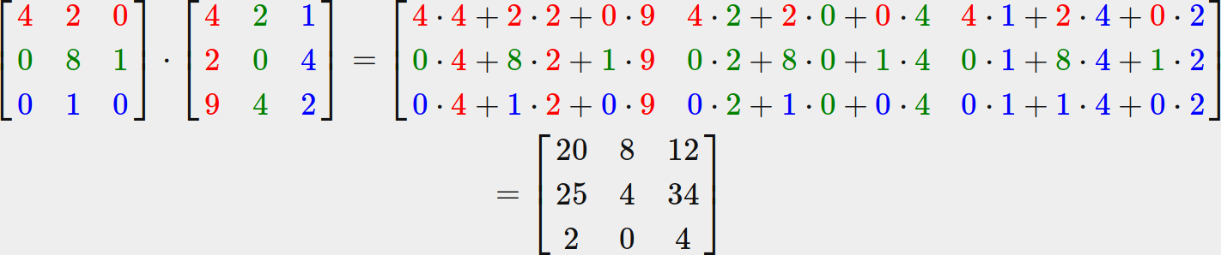
Matrix-Matrix Multiplication
We can think of the matrix-matrix multiplication $AB$ as performing $m$ matrix-vector products and stitching the results together to form an $n×m$ matrix.
Matrix-Matrix Multiplication
In the following snippet, we perform matrix multiplication on A and B.
B = np.ones(shape=(4,3))
np.dot(A,B)

Slide 34
Contents
CH2
Data Manipulation
Data Preprocessing
Linear Algebra
Linear Algebra cont.
Calculus
Automatic Differentiation
Probability
Documentation
Getting Started
Reading the Dataset
Scalars
Reduction
Derivatives and Differentiation
A Simple Example
Basic Probability Theory
Finding All the Functions and Classes in a Module
Operations
Handling Missing Data
Vectors
Dot Products
Partial Derivatives
Backward for Non-Scalar Variables
Dealing with Multiple Random Variables
Finding the Usage of Specific Functions and Classes
Broadcasting Mechanism
Conversion to the Tensor Format
Matrices
Matrix-Vector Products
Gradients
Detaching Computation
Expectation and Variance
Indexing and Slicing
Tensors
Matrix-Matrix Multiplication
Chain Rule
Computing the Gradient of Python Control Flow
Saving Memory
Basic Properties of Tensor Arithmetic
Norms
Conversion to Other Python Objects
+6 sections
More on Linear Algebra

Slide 35
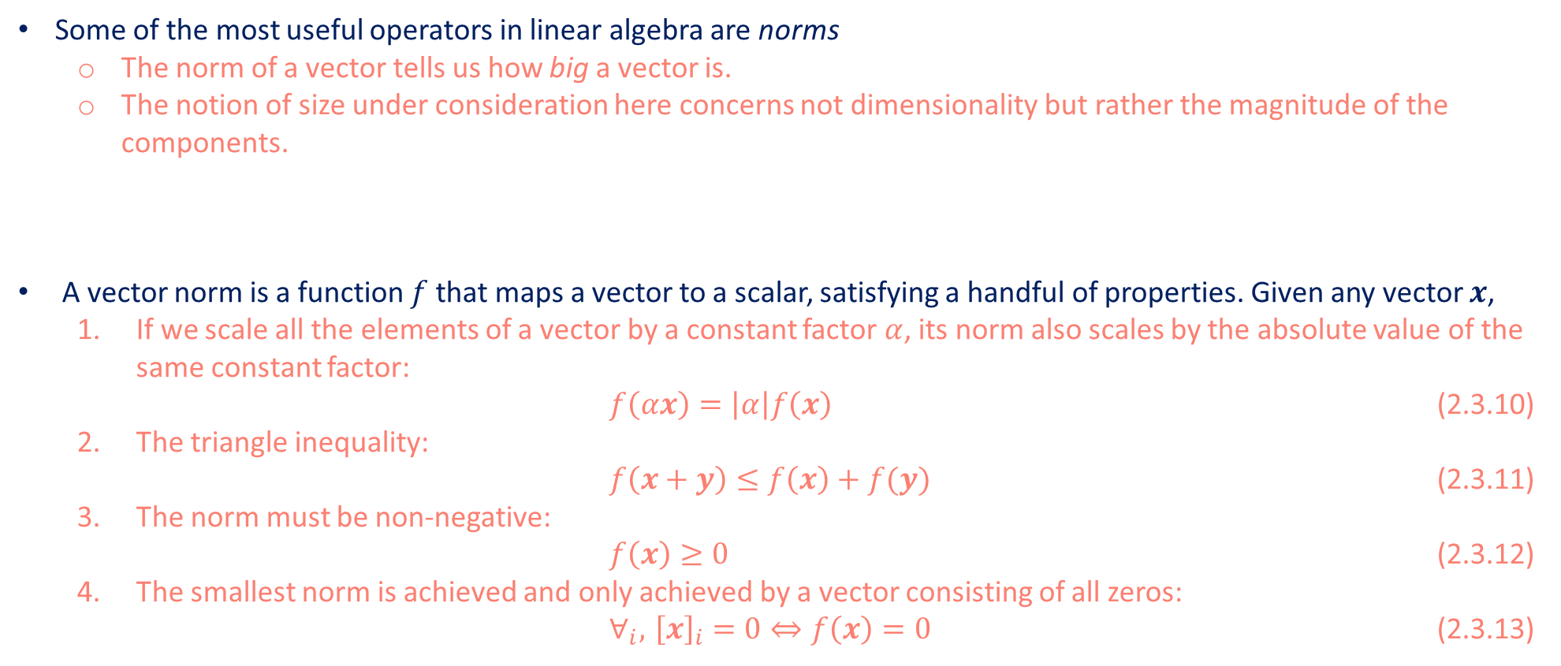
Norms
Some of the most useful operators in linear algebra are norms
The norm of a vector tells us how big a vector is.
The notion of size under consideration here concerns not dimensionality but rather the magnitude of the components.
A vector norm is a function $f$ that maps a vector to a scalar, satisfying a handful of properties. Given any vector $x$,
If we scale all the elements of a vector by a constant factor $α$, its norm also scales by the absolute value of the same constant factor:
$f\left(αx\right)=\left|α\right|f\left(x\right)$ (2.3.10)
The triangle inequality:
$f\left(x+y\right)≤f\left(x\right)+f(y)$ (2.3.11)
The norm must be non-negative:
$f\left(x\right)≥0$ (2.3.12)
The smallest norm is achieved and only achieved by a vector consisting of all zeros:
$∀_{i}, { \left[x\right]}_{i }=0⇔f\left(x\right)=0$ (2.3.13)

Slide 36
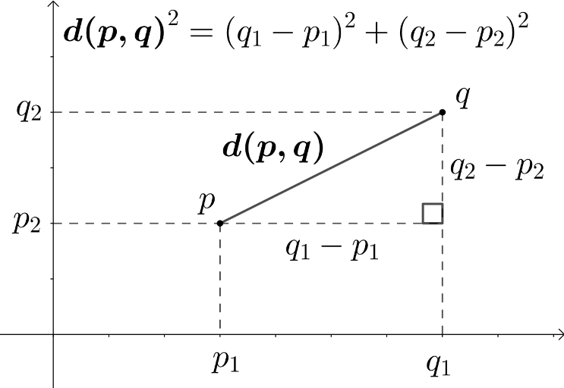

Norms
The Euclidean distance is a norm: specifically it is the $L2$ norm.
Suppose that the elements in the $n$-dimensional vector $x$ are $x_{1},…,x_{n}$. The L2 norm of $x$ is the square root of the sum of the squares of the vector elements:
${\left\|x\right\|}_{2}= \sqrt{\sum_{i=1}^{n}{x_{i}^{2}}}$ (2.3.14)
In code, we can calculate the L2 norm of a vector as follows.
Euclidean distance in R²
u = np.array([3, -4])
np.linalg.norm(u)

Slide 37
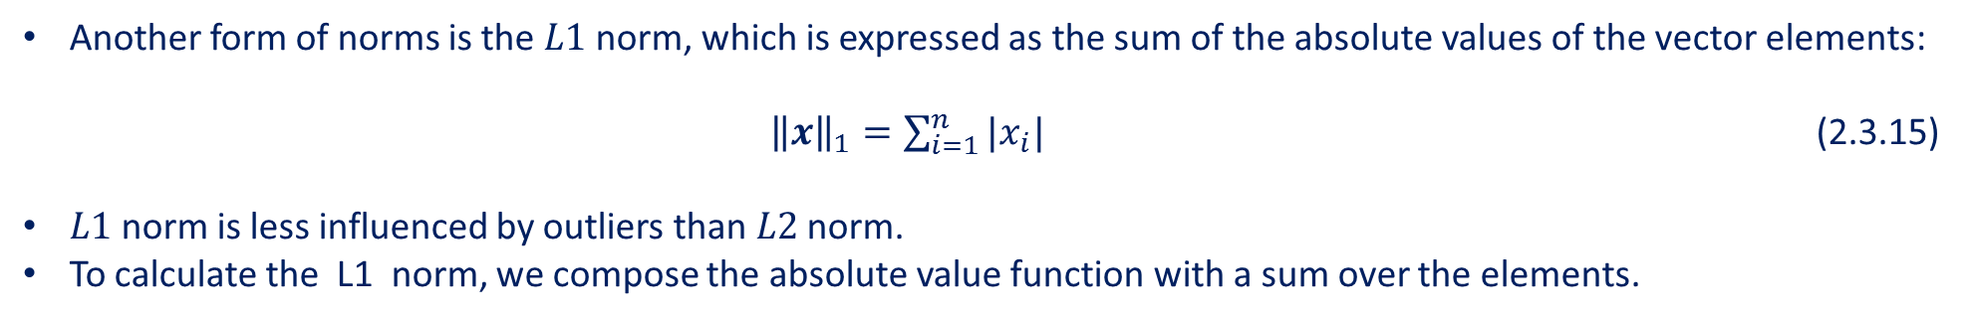
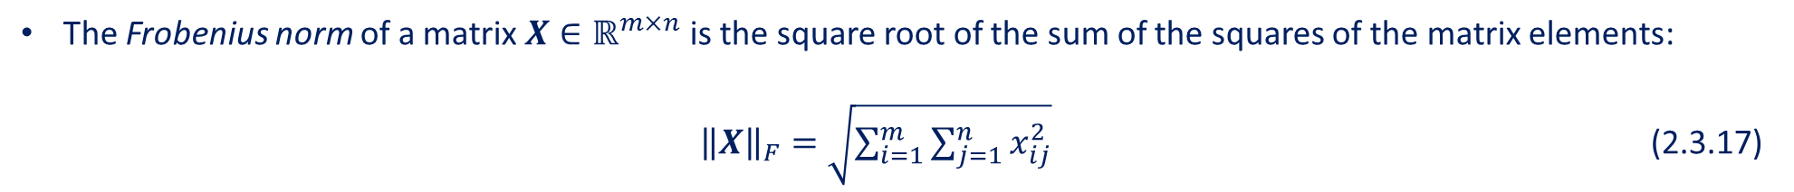
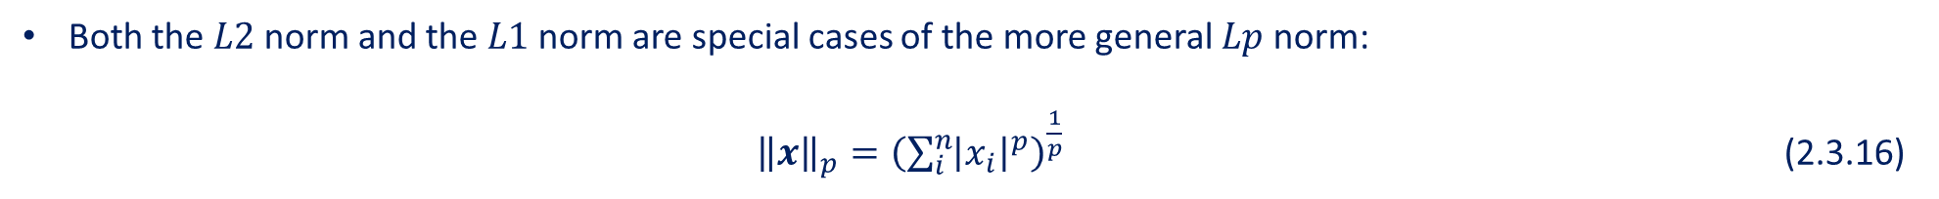
Norms
Another form of norms is the $L1$ norm, which is expressed as the sum of the absolute values of the vector elements:
${\left\|x\right\|}_{1}=\sum_{i=1}^{n}{|x_{i}|}$ (2.3.15)
$L1$ norm is less influenced by outliers than $L2$ norm.
To calculate the L1 norm, we compose the absolute value function with a sum over the elements.
np.abs(u).sum()
Both the $L2$ norm and the $L1$ norm are special cases of the more general $Lp$ norm:
${\left\|x\right\|}_{p}={\left(\sum_{i}^{n}{{\left|x_{i}\right|}^{p}}\right)}^{\frac{1}{p}}$ (2.3.16)
The Frobenius norm of a matrix $X∈ℝ^{m×n}$ is the square root of the sum of the squares of the matrix elements:
${\left\|X\right\|}_{F}=\sqrt{\sum_{i=1}^{m}{\sum_{j=1}^{n}{x_{ij}^{2}}}}$ (2.3.17)

Slide 38
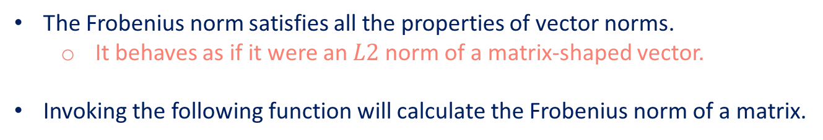
Norms
The Frobenius norm satisfies all the properties of vector norms.
It behaves as if it were an $L2$ norm of a matrix-shaped vector.
Invoking the following function will calculate the Frobenius norm of a matrix.
np.linalg.norm(np.ones((4,9)))
Why norms are useful?
In deep learning, we are often trying to solve optimization problems.
Optimization: maximize the probability assigned to observed data; minimize the distance between predictions and the ground-truth observations.
Assign vector representations to items (like words, products, or news articles) such that the distance between similar items is minimized, and the distance between dissimilar items is maximized.
The objectives are expressed as norms.

Slide 39
Contents
CH2
Data Manipulation
Data Preprocessing
Linear Algebra
Linear Algebra cont.
Calculus
Automatic Differentiation
Probability
Documentation
Getting Started
Reading the Dataset
Scalars
Reduction
Derivatives and Differentiation
A Simple Example
Basic Probability Theory
Finding All the Functions and Classes in a Module
Operations
Handling Missing Data
Vectors
Dot Products
Partial Derivatives
Backward for Non-Scalar Variables
Dealing with Multiple Random Variables
Finding the Usage of Specific Functions and Classes
Broadcasting Mechanism
Conversion to the Tensor Format
Matrices
Matrix-Vector Products
Gradients
Detaching Computation
Expectation and Variance
Indexing and Slicing
Tensors
Matrix-Matrix Multiplication
Chain Rule
Computing the Gradient of Python Control Flow
Saving Memory
Basic Properties of Tensor Arithmetic
Norms
Conversion to Other Python Objects
+6 sections
More on Linear Algebra

Slide 40
Norms
There are entire subfields of machine learning that focus on using matrix decompositions and their generalizations to high-order tensors to discover structure in datasets and solve prediction problems.
If you are eager to learn more about linear algebra, you may refer to either the online appendix on linear algebraic operations or other excellent resources [Strang, 1993][Kolter, 2008][Petersen et al., 2008].

Slide 41
Summary
Scalars, vectors, matrices, and tensors are basic mathematical objects in linear algebra.
Vectors generalize scalars, and matrices generalize vectors.
Scalars, vectors, matrices, and tensors have zero, one, two, and an arbitrary number of axes, respectively.
A tensor can be reduced along the specified axes by sum and mean.
Elementwise multiplication of two matrices is called their Hadamard product. It is different from matrix multiplication.
In deep learning, we often work with norms such as the L1 norm, the L2 norm, and the Frobenius norm.
We can perform a variety of operations over scalars, vectors, matrices, and tensors.

